Slide 1
Engineering a Hydrogen Industry for Australia Dr. Patrick Hartley CSIRO Energy
‘The Sustainable Hydrogen & Ammonia Economy’ Engineers Australia, Melbourne 7/5/19
Notes:
Good Morning and thanks to the organizers for the opportunity to present some of our work on the topic of hydrogen industry development in Australia

Slide 2
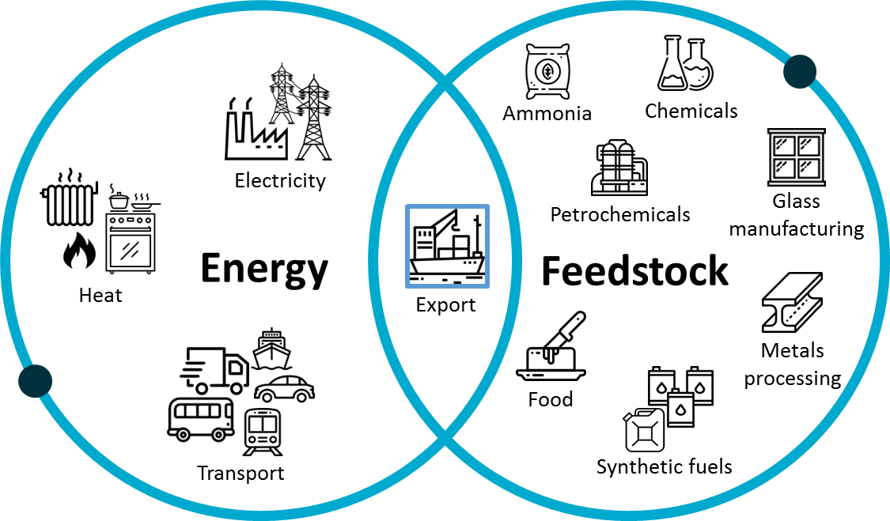
Why Hydrogen for Australia?
Hydrogen can be used to decarbonize diverse energy & feedstock value chains
Notes:
So Firstly, why hydrogen?
Hydrogen is a versatile energy carrier that can be used in many energy and feedstock applications,
And of course in the centre of the diagram, we have the export opportunity which is something more uniques to Australia, and which I’ll come back to later in the talk.

Slide 3
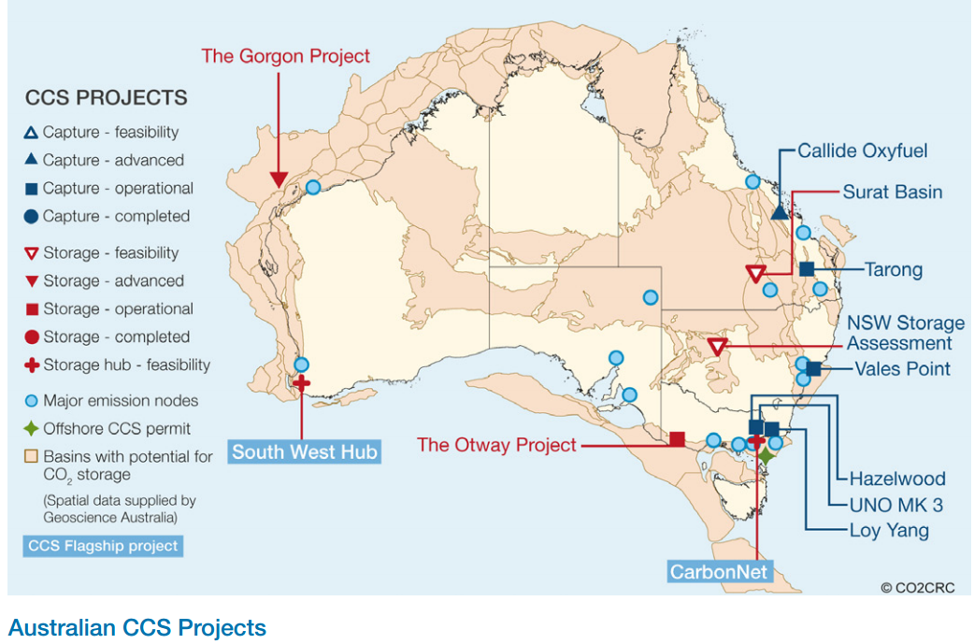
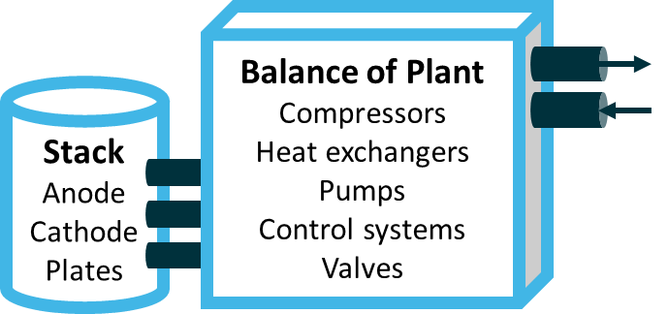
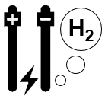
Hydrogen Production Pathways
Mature Technologies for Australia
Fossil fuel derived: Using coal / gas feedstocks to produce hydrogen.
Steam methane reforming (SMR) and coal gasification widely used at scale globally
Carbon capture & storage (CCS) is required to produce clean hydrogen.
H₂
CO₂
Electrolysis: Involves the use of an electrical current to split water into hydrogen and oxygen.
Requires the use of low or zero emissions eg solar electricity.
Mature technologies include polymer electrolyte membrane (PEM) and alkaline electrolysis (AE).
H₂
+
Water Treatment
Notes:
I mentioned Australia’s abundant resources earlier. Technologies to produce hydrogen from fossil fuels are mature, but CCS needs to be developed further to deal with the CO2 emissions which arise from the processes in order to produce clean hydrogen
Australia also has world class expertise and CCS resources which can be developed in this direction
Meanwhile The renewable energy pathway which relies on the use of renewable energy to split water is inherently zero emissions. Whilst at smaller scale, the technologies here are quite mature also.

Slide 4
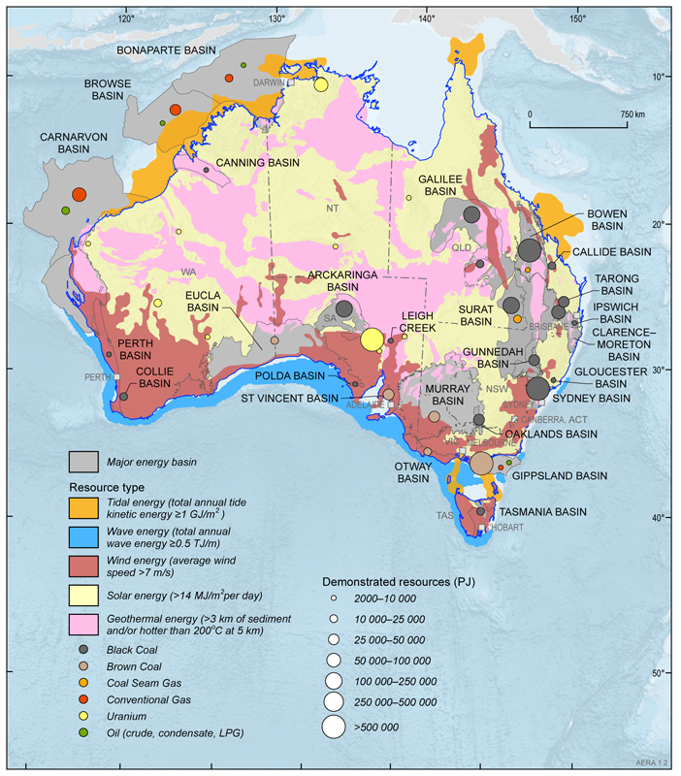
Why Hydrogen for Australia?
Australia has abundant resources which can be used for hydrogen production
Notes:
A key element of the opportunity for Australia is our wealth of both renewable and fossil energy sources, both of which can be used for producing clean hydrogen

Slide 5
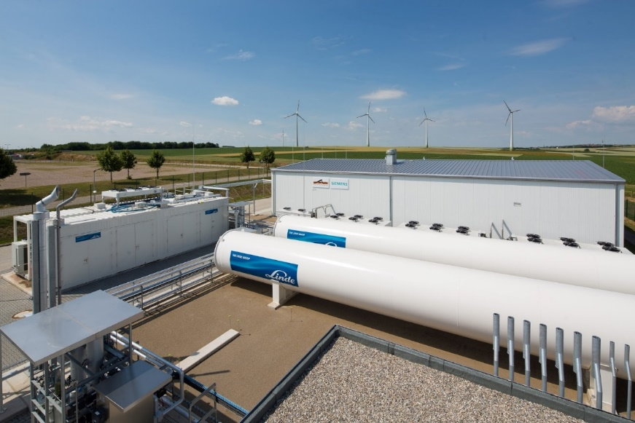
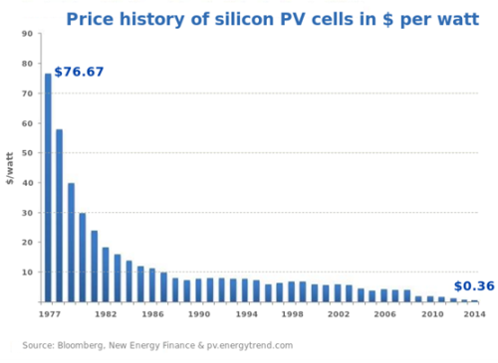
…..So Why Now?
Globally, the hydrogen industry is now underpinned by a series of mature technologies
The costs of of renewable energy have fallen dramatically making hydrogen production from these resources cost competitive for energy applications
Emerging overseas markets for low emissions energy (eg Japan & Korea)
The hydrogen industry narrative has shifted from technology development to market activation
Notes:
But we’ve been here before. People have been promoting the potential of hydrogen since the 1970’s and earlier (Jules Verne).
There are some key reasons for its recent re-emergence. One is the increasing international focus on emissions reduction, but there are sound commercial reasons also. These are
the underpinning technologies are largely mature
Falling renewable energy prices
Emerging overseas markets
All of these factors mean that the industry narrative has shifted to ‘Market Activation’

Slide 6
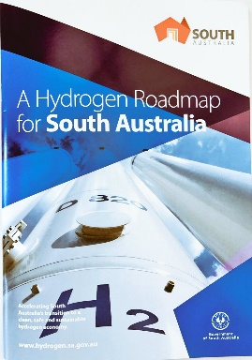
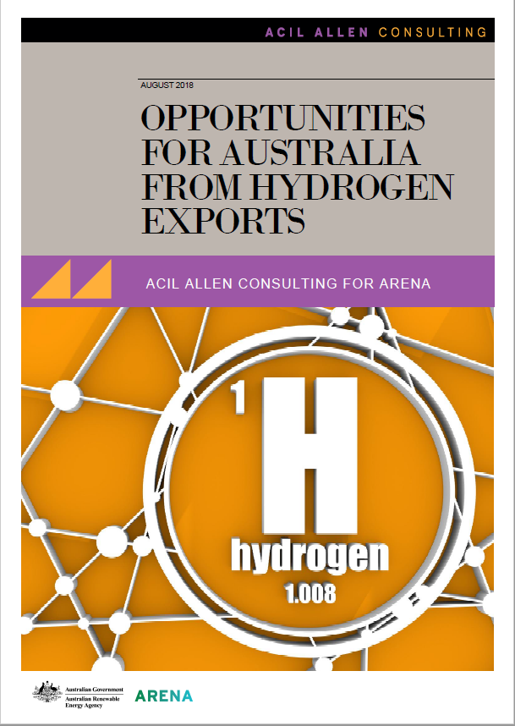
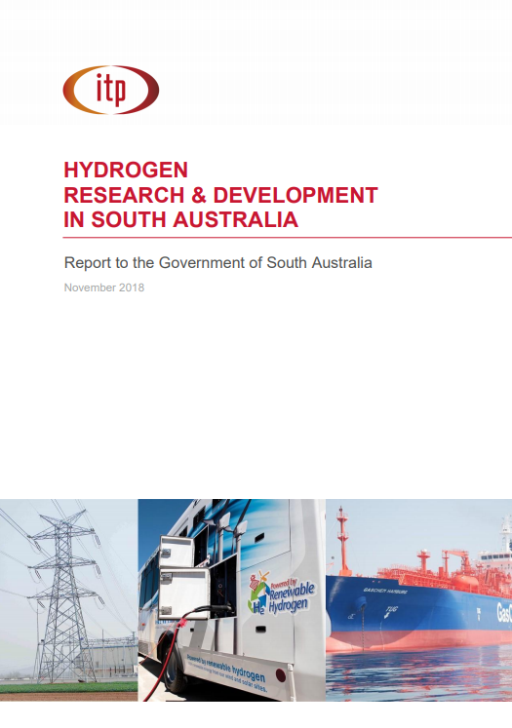
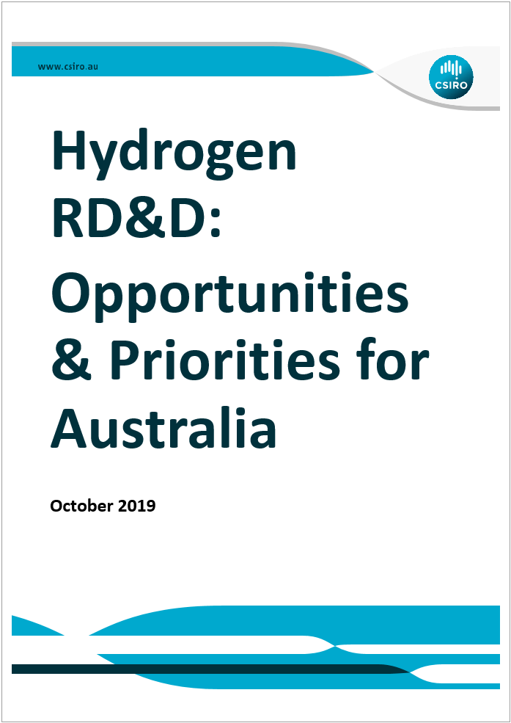
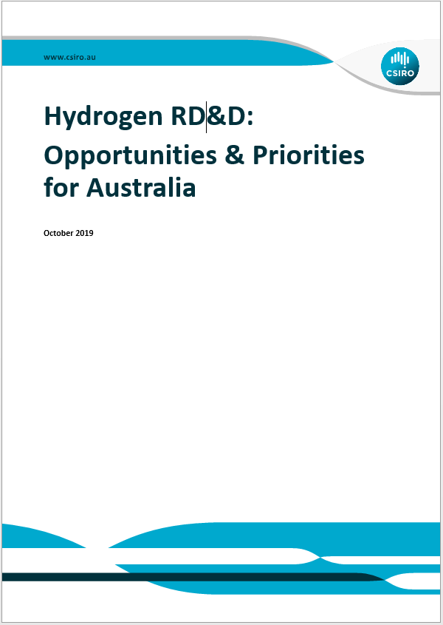
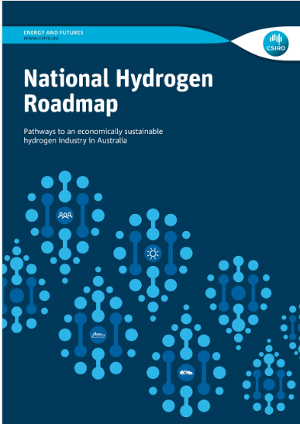
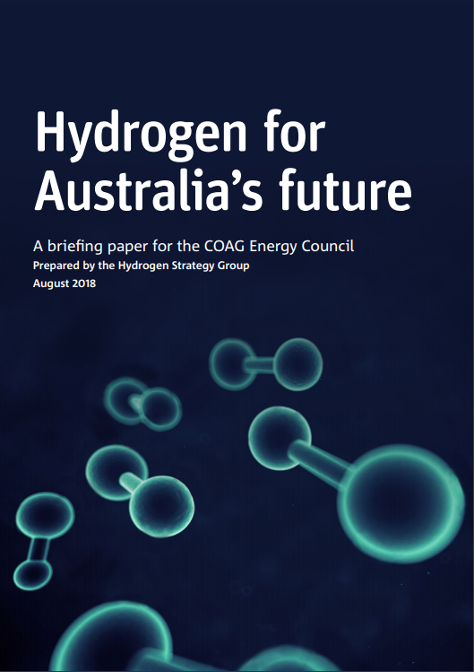
Hydrogen in Australia: The (Recent) Story So Far
September 2017
Hydrogen Roadmap for South Australia
August 2018
National Hydrogen Roadmap is released by CSIRO
August 2018
Hydrogen for Australia’s Future, by the Hydrogen Strategy Council for COAG Energy Council
December 2018
COAG Energy Council approves National Strategy Taskforce
December 2019
COAG Energy Council: National Hydrogen Strategy
August 2018
Australia’s Hydrogen Export Opportunities, commissioned by ARENA
November 2018
Report: Hydrogen R&D in South Australia
Today 2019
CSIRO Report Hydrogen RD&D: Opportunities & Priorities for Australia
Notes:
And so now let’s look at where the applications sit.
The first set of applications are where the cost of hydrogen is already competitive. That is in vehicle applications, where the incumbent energy source is typically diesel or petrol. These applications are still hampered by infrastructure barriers (for example refuelling stations) however, which sit outside this analysis
In the second set of applications, we see hydrogen becoming costs competitive once the cost of hydrogen has dropped towards our best case scenario. Again, infrastructure barriers will likely apply to these also, but are not modelled here.
In the 3rd and 4th set of applications, the low cost of the incumbent energy source (for example natural gas for residential heating), means either that the cost of hydrogen will need to drop further than the scenario, or the existing costs will need to increase in order for hydrogen to displace the incumbent.
And so this graph essentially identifies the ‘low hanging fruit’ for an Australian Hydrogen Industry.
Now, let’s zoom in on one of these application areas which is particularly important to Australia, Export

Slide 7
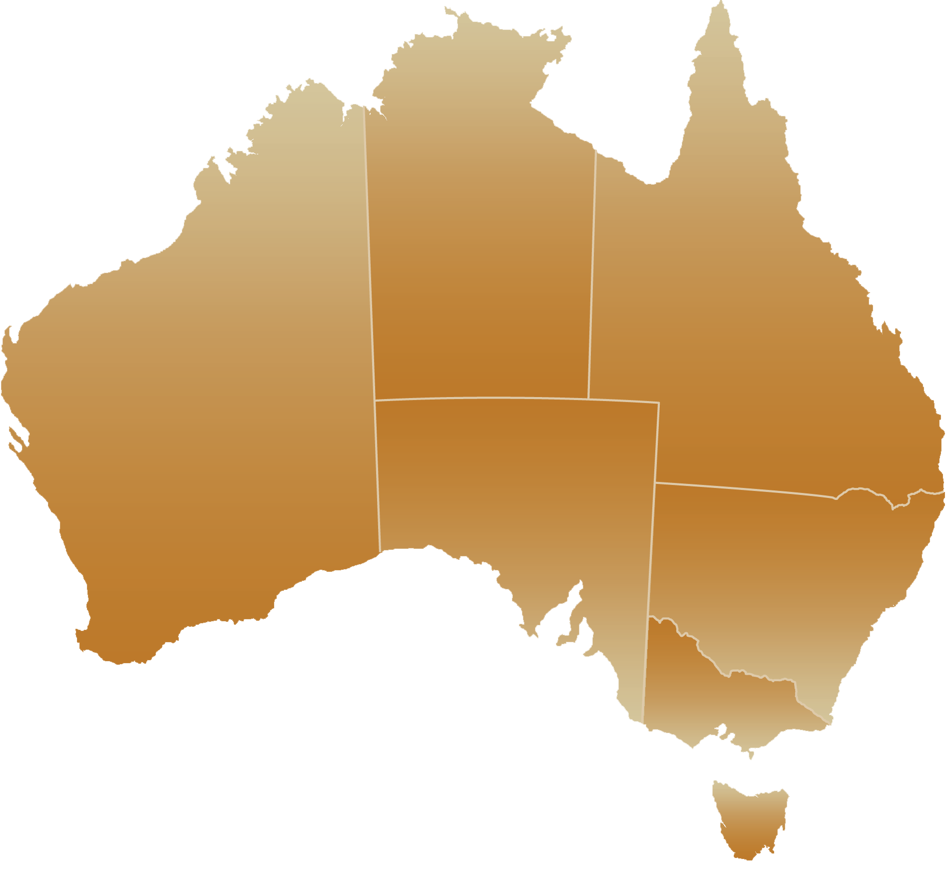
Demonstration Activities in Australia
Renewable Hydrogen/Ammonia
Yara & ENGIE
Gladstone Advanced Biofuels Pilot Plant Northern Oil & AFC Energy
Sir Samuel Griffith Centre
Griffith University
Clean Energy Innovation Hub
ATCO
Hazer Group Pilot Plant
Hazer Group
Project H₂GO
Jemena
Hazer Group Pilot Plant
MinRes
Hazer Group Pilot Plant
Hazer Group
Government Fleet and Refuelling station
Noeon, Megawatt Capital, Siemens & Hyundai
Port Lincoln Green Hydrogen Plant
Hydrogen Utility (H2U) & thyssenkrupp
Renewable Energy to Gas
Union Fenosa, ANU & ActewAGL Distribution
Crystal Brook Energy Park
Neoen
In Progress
Mawson Lakes Campus
UniSA
Hydrogen Energy Supply Chain (HESC)
Kawasaki Heavy Industries (KHI), J-POWER, Iwatani Corporation, Marubeni Corporation, Shell & AGL
Investigation / Study
Toyota Australia Hydrogen Centre
Toyota Australia
Completed
Hydrogen Park SA (HyP SA)
AGIG & Siemens
Notes:
And of course it’s important to highlight the very real steps which many industry players are taking across Australia right now t make this industry a reality.

Slide 8
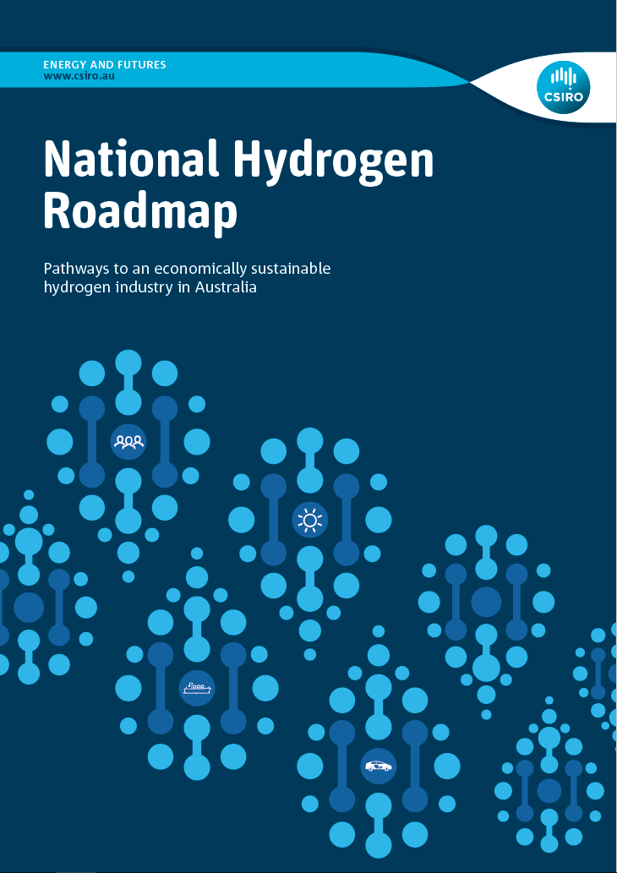
CSIRO National Hydrogen Roadmap
Primary objective: Assessment of Australian hydrogen opportunities to help inform and coordinate industry investment & government policy
Secondary objective: Bring together the broad H2 stakeholder group (industry, government, research) to develop a clear view of the opportunity for Australia
Electricity Generation & Storage
Energy storage
Grid support
Remote Energy
Direct Combustion
Residential / Commercial
Gas distribution network
Transport
Passenger vehicles
Heavy vehicles
Shipping
Rail
Export Commodity
Hydrogen
Ammonia
Methanol
Synth. Natural Gas
Industrial Feedstock
Petrochemical
Metallurgy
Chemicals
Synthetic fuels
Notes:
So why did we undertake this piece of work?
Primary and Secondary Objectives
In our study, we considered opportunities across the energy and industrial sectors

Slide 9
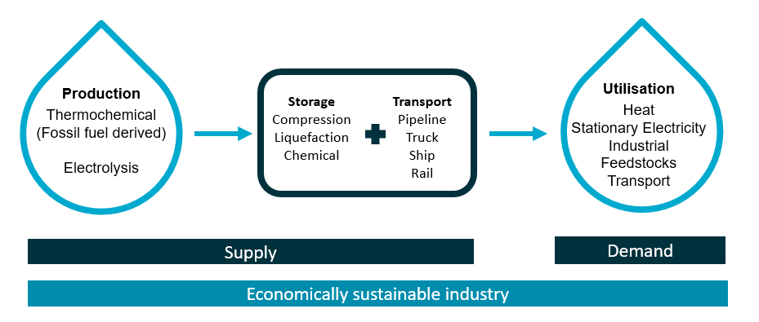
Hydrogen value chains
Notes:
We structured our assessment using a value chain approach, and confined the analysis to key mature technologies

Slide 10
Hydrogen Applications & The Cost Competitiveness Curve
$/kg
Passenger vehicles
Roadmap H₂ supply cost projection (Electrolysis)
Infrastructure barrier
Base case (2018) H₂ supply cost barrier
Best case (˜2025) H₂ supply cost barrier
Buses
Infrastructure and H₂ supply cost barrier
Trucks
Remote Area Power Systems
Export
Industrial feedstocks
Residential heat
Grid firming services
Synthetic fuels
2020
2025
2030
Notes:
And so now let’s look at where the applications sit.
The first set of applications are where the cost of hydrogen is already competitive. That is in vehicle applications, where the incumbent energy source is typically diesel or petrol. These applications are still hampered by infrastructure barriers (for example refuelling stations) however, which sit outside this analysis
In the second set of applications, we see hydrogen becoming costs competitive once the cost of hydrogen has dropped towards our best case scenario. Again, infrastructure barriers will likely apply to these also, but are not modelled here.
In the 3rd and 4th set of applications, the low cost of the incumbent energy source (for example natural gas for residential heating), means either that the cost of hydrogen will need to drop further than the scenario, or the existing costs will need to increase in order for hydrogen to displace the incumbent.
And so this graph essentially identifies the ‘low hanging fruit’ for an Australian Hydrogen Industry.
Now, let’s zoom in on one of these application areas which is particularly important to Australia, Export

Slide 11
Hydrogen Applications: A World of Engineering Opportunity
$/kg
Passenger vehicles
Buses
Trucks
Remote Area Power Systems
Export
Industrial feedstocks
Residential heat
Grid firming services
Synthetic fuels
2020
2025
2030
Notes:
And so now let’s look at where the applications sit.
The first set of applications are where the cost of hydrogen is already competitive. That is in vehicle applications, where the incumbent energy source is typically diesel or petrol. These applications are still hampered by infrastructure barriers (for example refuelling stations) however, which sit outside this analysis
In the second set of applications, we see hydrogen becoming costs competitive once the cost of hydrogen has dropped towards our best case scenario. Again, infrastructure barriers will likely apply to these also, but are not modelled here.
In the 3rd and 4th set of applications, the low cost of the incumbent energy source (for example natural gas for residential heating), means either that the cost of hydrogen will need to drop further than the scenario, or the existing costs will need to increase in order for hydrogen to displace the incumbent.
And so this graph essentially identifies the ‘low hanging fruit’ for an Australian Hydrogen Industry.
Now, let’s zoom in on one of these application areas which is particularly important to Australia, Export

Slide 12
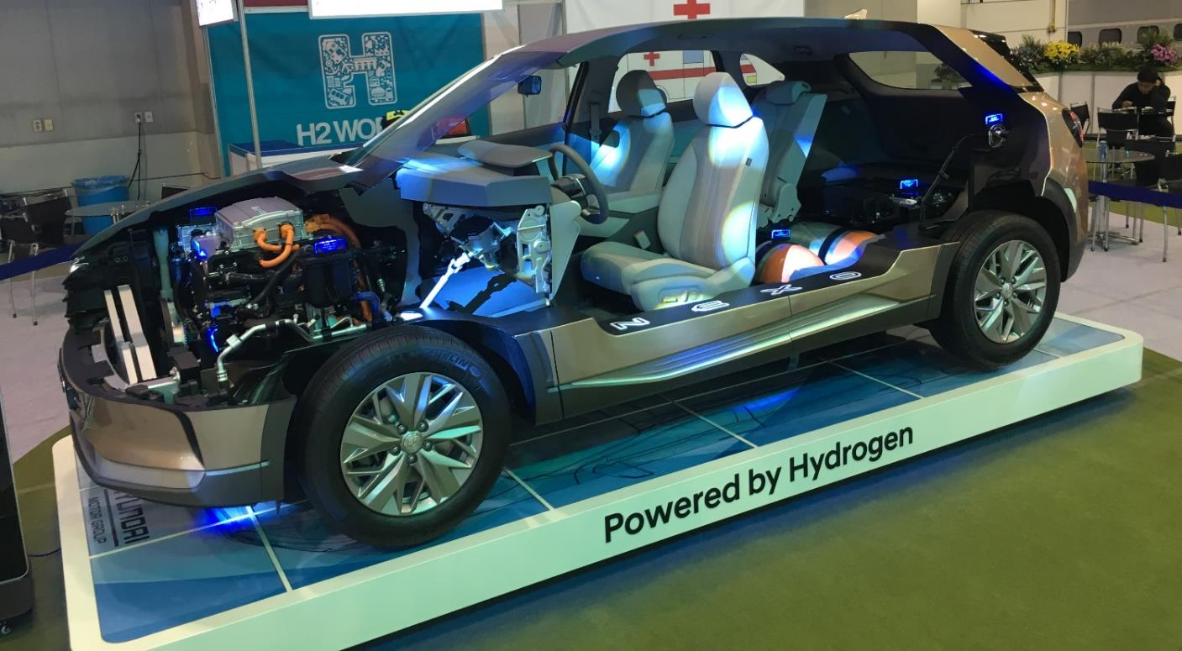
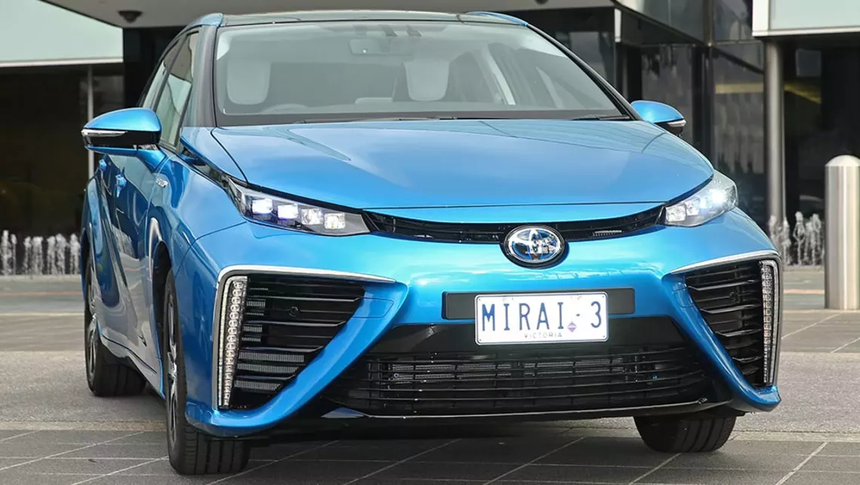
Hydrogen in Transport: Passenger FCEV
Fuel Cell Powertrain/Permanent Magnet Motor
Notes:
And so now let’s look at where the applications sit.
The first set of applications are where the cost of hydrogen is already competitive. That is in vehicle applications, where the incumbent energy source is typically diesel or petrol. These applications are still hampered by infrastructure barriers (for example refuelling stations) however, which sit outside this analysis
In the second set of applications, we see hydrogen becoming costs competitive once the cost of hydrogen has dropped towards our best case scenario. Again, infrastructure barriers will likely apply to these also, but are not modelled here.
In the 3rd and 4th set of applications, the low cost of the incumbent energy source (for example natural gas for residential heating), means either that the cost of hydrogen will need to drop further than the scenario, or the existing costs will need to increase in order for hydrogen to displace the incumbent.
And so this graph essentially identifies the ‘low hanging fruit’ for an Australian Hydrogen Industry.
Now, let’s zoom in on one of these application areas which is particularly important to Australia, Export

Slide 13
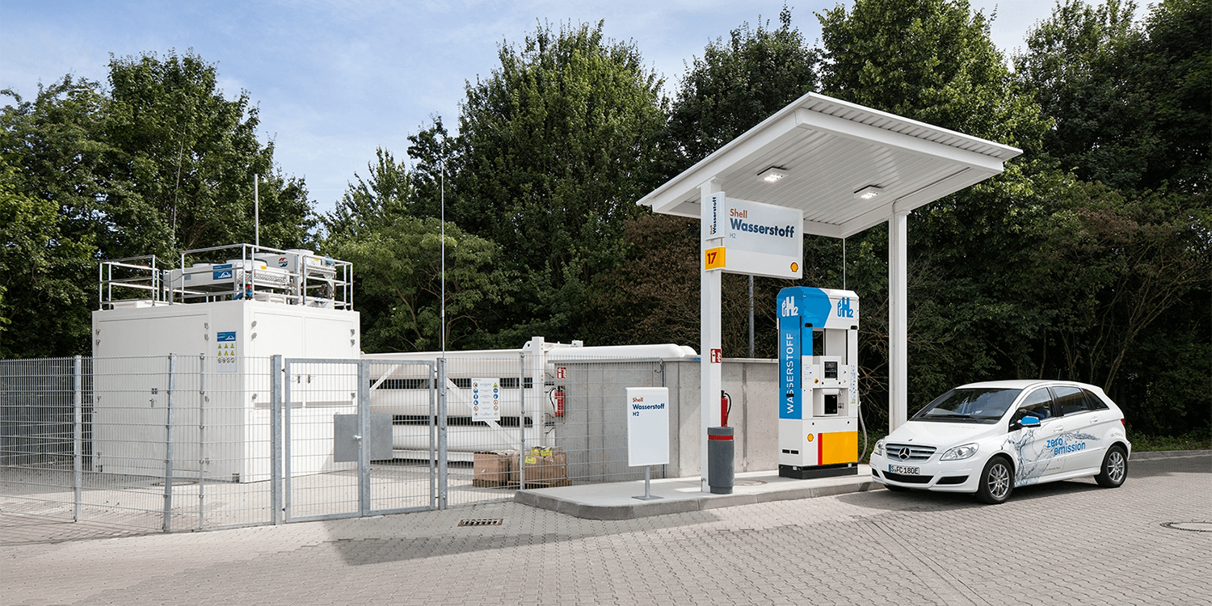
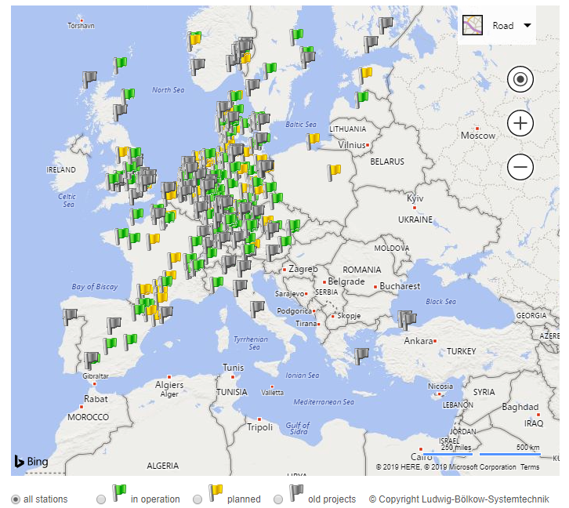
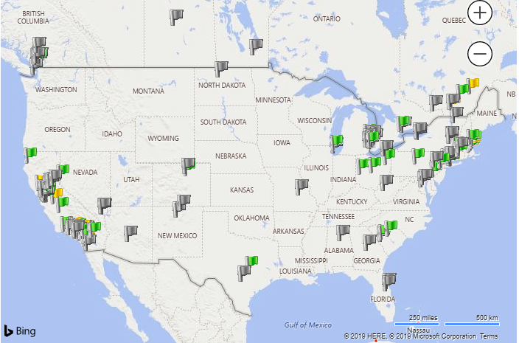
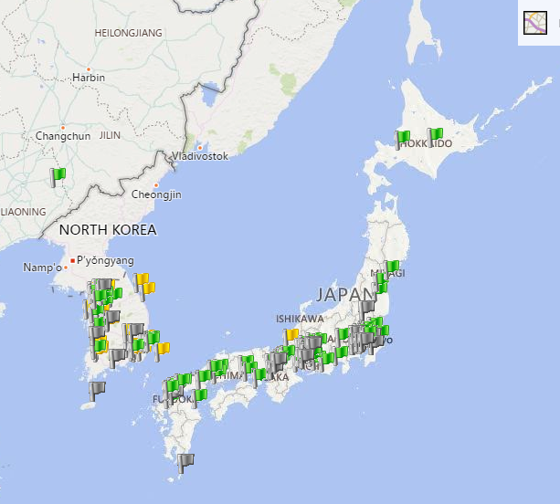
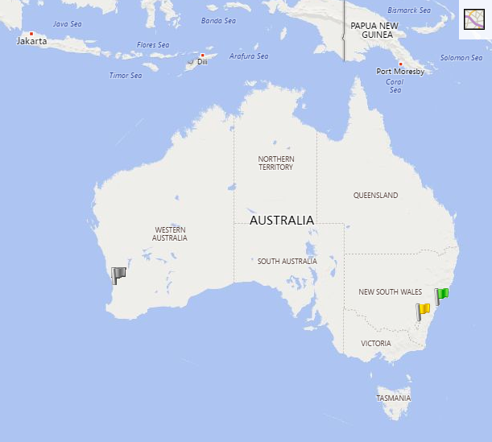
Hydrogen in Transport: Refuelling Infrastructure
Notes:
And so now let’s look at where the applications sit.
The first set of applications are where the cost of hydrogen is already competitive. That is in vehicle applications, where the incumbent energy source is typically diesel or petrol. These applications are still hampered by infrastructure barriers (for example refuelling stations) however, which sit outside this analysis
In the second set of applications, we see hydrogen becoming costs competitive once the cost of hydrogen has dropped towards our best case scenario. Again, infrastructure barriers will likely apply to these also, but are not modelled here.
In the 3rd and 4th set of applications, the low cost of the incumbent energy source (for example natural gas for residential heating), means either that the cost of hydrogen will need to drop further than the scenario, or the existing costs will need to increase in order for hydrogen to displace the incumbent.
And so this graph essentially identifies the ‘low hanging fruit’ for an Australian Hydrogen Industry.
Now, let’s zoom in on one of these application areas which is particularly important to Australia, Export

Slide 14
Hydrogen Applications: A World of Engineering Opportunity
$/kg
Passenger vehicles
Buses
Trucks
Remote Area Power Systems
Export
Industrial feedstocks
Residential heat
Grid firming services
Synthetic fuels
2020
2025
2030
Notes:
And so now let’s look at where the applications sit.
The first set of applications are where the cost of hydrogen is already competitive. That is in vehicle applications, where the incumbent energy source is typically diesel or petrol. These applications are still hampered by infrastructure barriers (for example refuelling stations) however, which sit outside this analysis
In the second set of applications, we see hydrogen becoming costs competitive once the cost of hydrogen has dropped towards our best case scenario. Again, infrastructure barriers will likely apply to these also, but are not modelled here.
In the 3rd and 4th set of applications, the low cost of the incumbent energy source (for example natural gas for residential heating), means either that the cost of hydrogen will need to drop further than the scenario, or the existing costs will need to increase in order for hydrogen to displace the incumbent.
And so this graph essentially identifies the ‘low hanging fruit’ for an Australian Hydrogen Industry.
Now, let’s zoom in on one of these application areas which is particularly important to Australia, Export

Slide 15
Hydrogen Export Partnerships
Australia has the resources and skills to build a sustainable hydrogen export industry
Australia’s comparative advantage:
Extensive natural resources (solar, wind, fossil fuels, CO₂ storage, available land)
Geographical proximity
Existing trade relationships (e.g. JAEPA, KAFTA)
Existing Energy Resource Trade (eg LNG)
Skilled workforce
¹Japan-Australia Economic Partnership Agreement agreed in January 2015
Notes:
Australia is well positioned to develop collaborations with Japan and Korea in this area

Slide 16
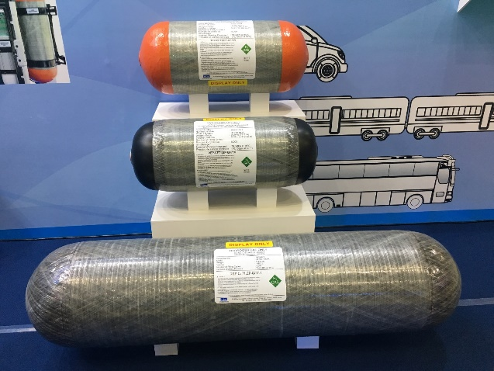
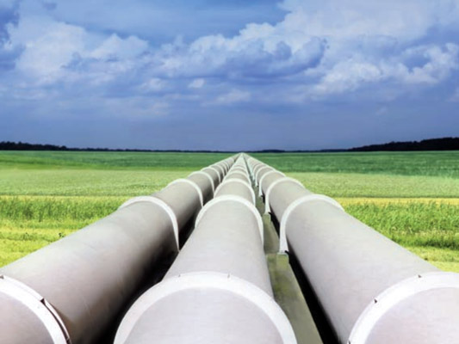
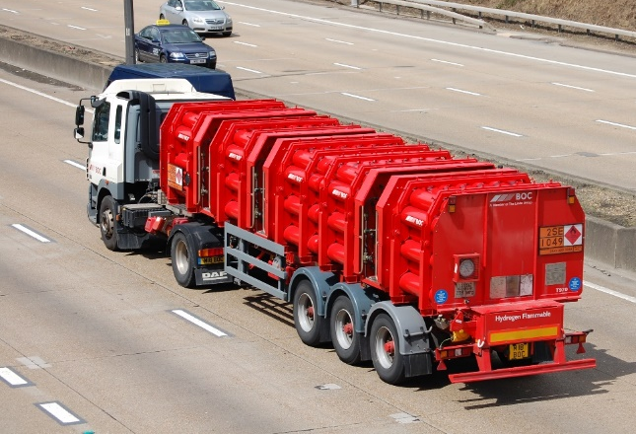
Realizing The Export Opportunity: Transporting Hydrogen
Transportation Options
H₂ has a low volumetric density (kg/m³) and hence energy density (MJ/m³) is low in its uncompressed gaseous state
Compression / liquefaction can increase the volumetric density for cost effective transport
Energy Carrier | Hydrogen Density (kg/m³)
Hydrogen Gas | 0.08
Compressed hydrogen (20MPa) | 18
Compressed hydrogen (70MPa) | 42
Liquefied Hydrogen (-253ºC) | 71
Increasing cost
Large Scale Transport Options:
Notes:
OK, so now lets talk about how we can realize this opportunity.
The main challenge for hydrogen is that while it has a very high mass based energy density (because it is a light molecule) conversely it has a very low volume based energy density. In other words, it is light, but takes up a lot of space.
For this reason, technologies which increase hydrogen density are very important. The simplest is compression, and you can see in the table the density increase which can be achieved using this approach. At the extreme end is Hydrogen liquefaction, which has a high energy density, but is of course very expensive due to the very low temperatures required
Nonetheless, all of these approaches are being pursued commercially.
The top picture shows current automobile and bus hydrogen fuel tanks which operate up to 70Mpa and offer ~500km range,
Whilst at the bottom is a schematic of the liquefied hydrogen tanks which Kawasaki Heavy Industry is building in order to transport Liquid hydrogen produced here in Victoria to Japan.

Slide 17
Hydrogen transportation options
Volumetric density (kg H₂/m³)
Ammonia
Truck
Rail
100
Shipping
(Export)
75
Liquefaction
50
25
Compression
Pipeline
Distance (km)
1,000
2,000
3,000
4,000
Notes:
The same is true when considering transport options, where depending on the distance required and quantity, different modes of transport can be selected. Shippnig is preferred for long range transport by sea, which is what an Australian export industry will most likely require. High volumetric density approaches such as liquefaction or chemical carriers are required for this.

Slide 18
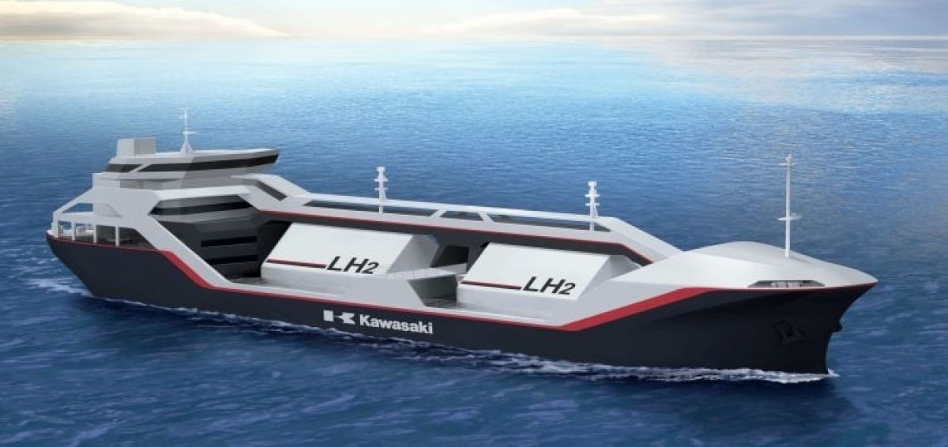
Large Scale Transport Options
Liquefied Hydrogen Shipping
Australia – Japan Interim Carriage Requirements agreed by IMO Maritime Safety Committee in November 2016

Slide 19
Liquefaction Export Pathway
Material Drivers of Cost
Landed CIF cost AU$4.61/kg (€2.84/kg) in 2025
Expected liquefaction cost contribution by 2025 is AU$1.75/kg (€1.08/kg)
Further cost reductions expected as the export industry matures & technology improves:
Electricity pricing
Plant capacity
R&D measures designed to improve plant efficiency and maintain temperature
Notes:
The CSIRO roadmap modelled the current and future cost requirements for the liquefaction pathway. Material cost drivers for reducing these were identified as
Electricity pricing
Plant capacity
R&D & Technology designed to improve plant efficiency and maintain temperature

Slide 20
Chemical Hydrogen Carriers
Transportation Options
Energy Carrier | Hydrogen Density (kg/m³)
Hydrogen Gas | 0.08
Compressed hydrogen (20MPa) | 18
Compressed hydrogen (70MPa) | 42
Liquefied Hydrogen (-253ºC) | 71
Hydrogen carrier technologies are available which improve density and avoid compression/liiqefaction, improving storage & transport economics
Decisions are a trade off between H2 quantity, capex footprint, cost & energy required plus:
Energy Carrier | Hydrogen Density (kg/m³) | Chemical Formula
Methane (LNG) | 108 | CH₄
Methanol | 99 | CH₃OH
Ammonia (25ºC, 1MPa) | 108 | NH₃
Methyl Cyclohexane (MCH) | 47 | C₇H₁₄
Other Carrier Considerations:
CO₂ neutral carbon sources required
Opportunity for other markets (fertilizer, petrochemical)
Toxicity concerns
Notes:
Another approach is to use chemistry to overcome some of the challenges in densifying hydrogen.
Here, hydrogen is reacted in various ways to produce liquid carriers which have high hydrogen density and which can be easily transported. An example which you’ll here more about in the next talk is ammonia. Each have pro’s and cons of course.

Slide 21
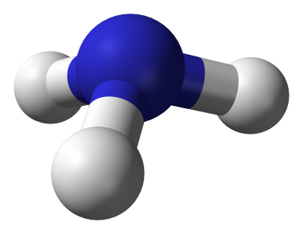
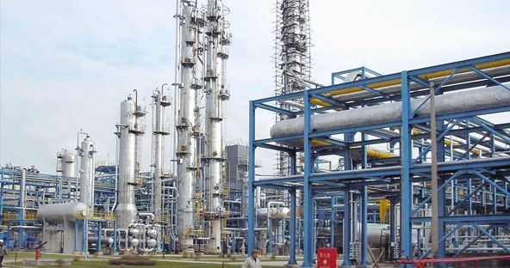
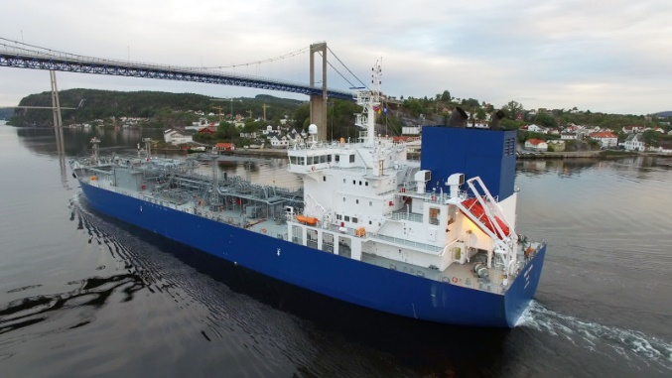
Ammonia Export Pathway
Ammonia Supply Chain
H₂
+
NH₃
NH₃
H₂
N₂
NH₃
N₂
Why Ammonia as a Hydrogen Carrier?
A carbon free, high hydrogen density molecule (kg/m³)
Synthesis and shipping is a mature, large scale industry
Globally traded commodity (fertilizer)
Opportunity to leverage existing infrastructure
Can be transported at room temperature / low pressure
Current cost as hydrogen carrier ˜AU$1.50/kg (¥11.5/Nm³)
Hydrogen recovery at point of use a technical / economic challenge
Notes:
We have also separately been looking at the ammonia supply chain option.
Here, hydrogen from either renewable or fossil sources is reacted with nitrogen in the air to produce ammonia which can be transported in large quantities by sea. Once at destination, the ammonia can either be directly used, for instance in a turbine or engine to produce electricity, or split to release the hydrogen fr other applications such as fuel cell vehicles.
This approach has the advantage of leveraging experience and existing large scale production and transport infrastructure.
One challenge which needs to be overcome, however, is reducing the cost of hydrogen regeneration from ammonia at scale. Which brings me to a new CSIRO technology development which we’re very excited about

Slide 22
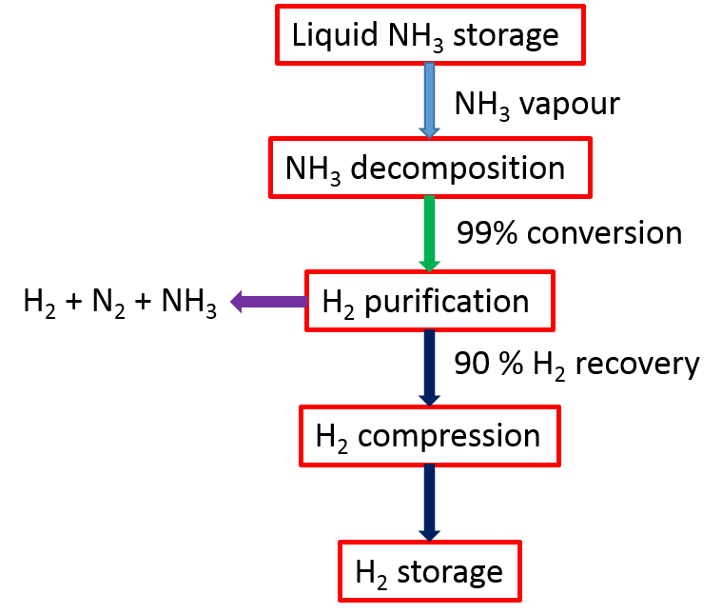
CSIRO Hydrogen Separation Membrane Technology
NH₃ + H₂ + N₂
H₂
H₂
H₂
Metal Tube
Membrane
NH₃ + N₂
Vanadium-based membranes for H₂ purification
Notes:
CSIRO has developed a new continuous process for cracking and separating hydrogen from ammonia. This allows hydrogen to be produced at high purity, which is what is required for refuelling fuel cell electic vehicles such as the Toyota Mirai and Hyundai Nexo, which we recently demonstrated at one of our research sites in Queensland

Slide 23
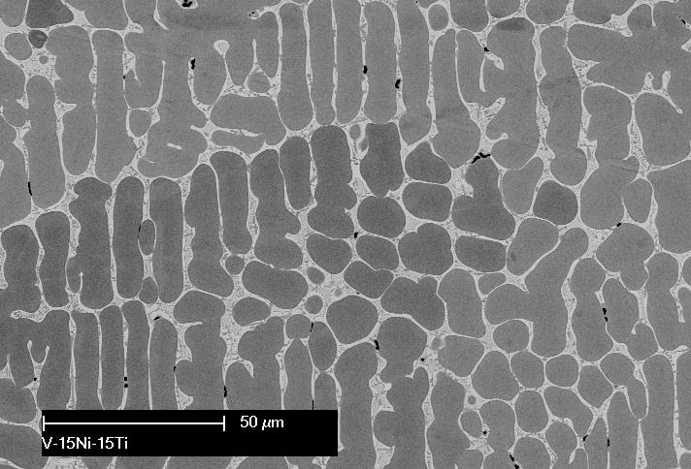
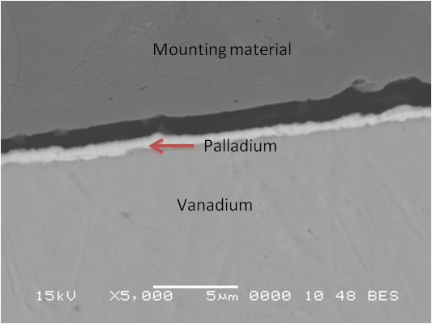
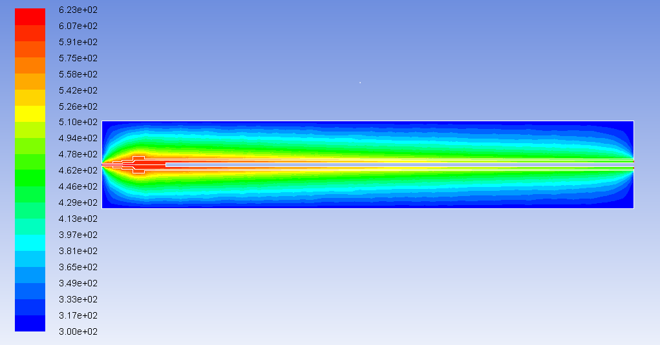
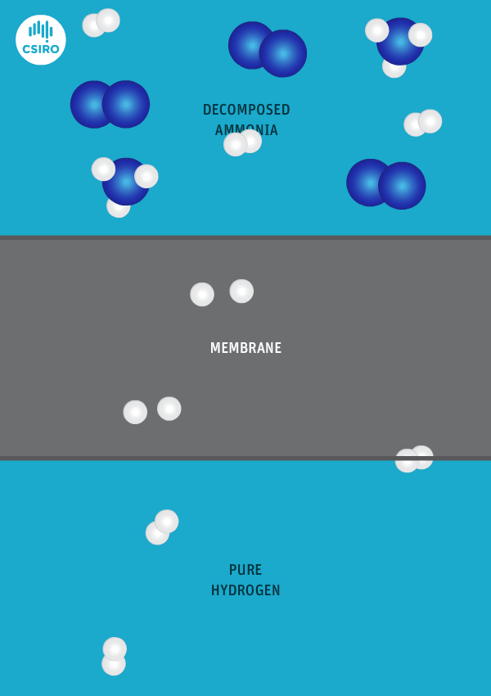
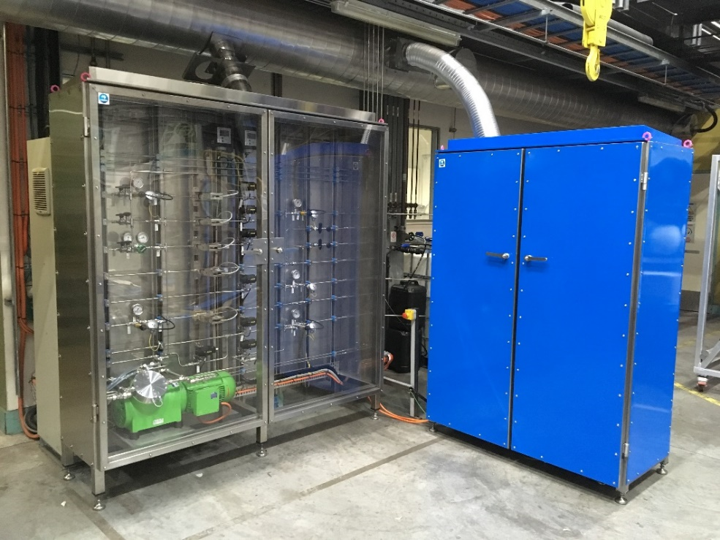
CSIRO Hydrogen Separation Membrane Technology
CSIRO NH3-to-H2 system (15kg / day)
Notes:
And this is how it works. The membrane is composed of metals which, under the right temperature and pressure conditions, allow hydrogen to pass through them, whilst blocking the unreacted ammonia and nitrogen by-product. Hydrogen passes through the membrane and can be captured and stored in pure form.
This sounds very simple, but required several years of careful materials development and characterization to be optimised such that the materials costs were in a range which makes the process economic.
We are currently scaling up this technology to the 100’s of kg hydrogen per day scale.

Slide 24
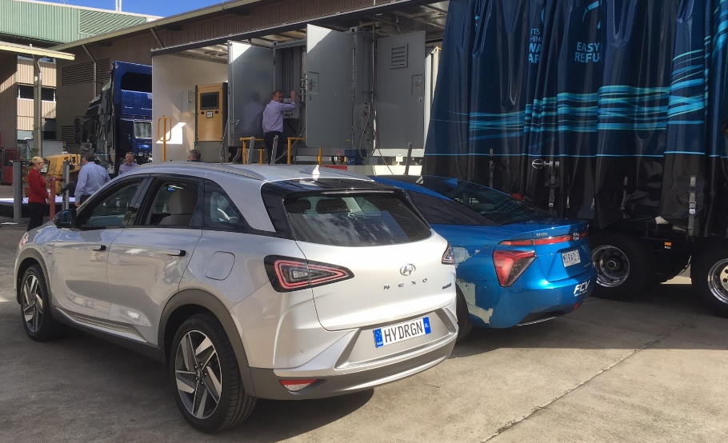
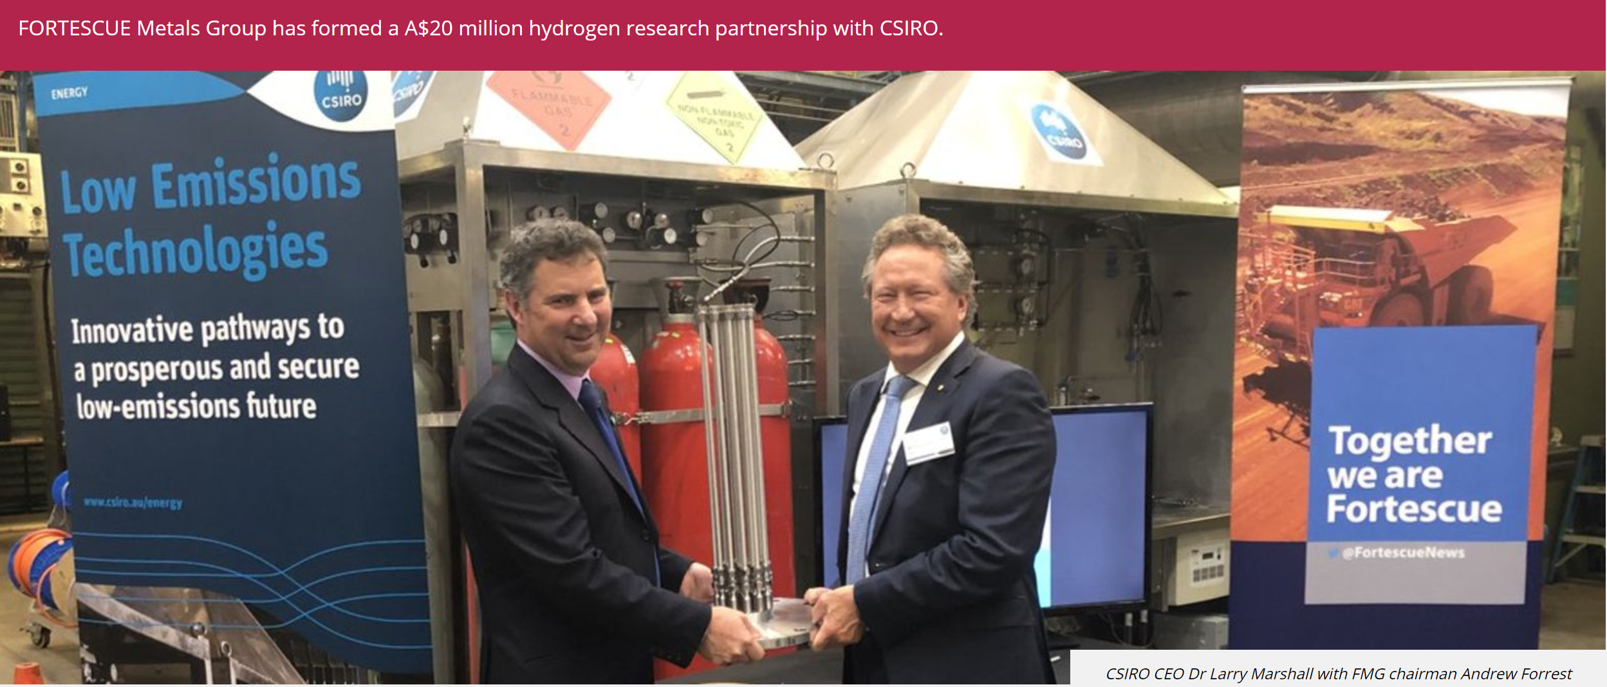
Refuelling Demonstration (August 2018)
CSIRO CEO Larry Marshall with FMG Chairman Andrew Forrest

Slide 25
CSIRO Roadmap: Key Messages
Hydrogen Technology is largely mature. Market activation is the key priority for developing an economically sustainable hydrogen industry in Australia
Barriers to market activation stem from both a lack of infrastructure supporting markets and cost of hydrogen supply
The opportunity for clean hydrogen to compete favourably on cost in many local applications is within reach and achievable by 2025.
The development of an export industry represents a potential ‘game changer’ for hydrogen and the broader energy sector due to associated increases in scale.
Development of an appropriate policy framework could create a local ‘market pull’ for hydrogen. Expect investment in value chain infrastructure to follow
Notes:
So that’s all I really wanted to cover, but just to return to the key messages from the CSIRO National Hydrogen Roadmap….

Slide 26
Our Next Project….
Support Ausralia’s National Hydrogen Strategy
Inform RD&D investment priorities and the development of international partnerships
Build a national hydrogen research & industry stakeholder network
Assess the current state of Australian hydrogen research
Inform research institutions to guide the development of research priorities and strategies
H₂
…….Stakeholders & Sponsors welcome!
Notes:
Finally, where are we going next?
Well, we are just commencing a study which aims to drill down on the roadmap in order to identify the opportunites for our research and innovation community to support the development of the industry.
Please feel free to catch up with me afterwards to discuss this further, or to drop me an e-mail….

Slide 27
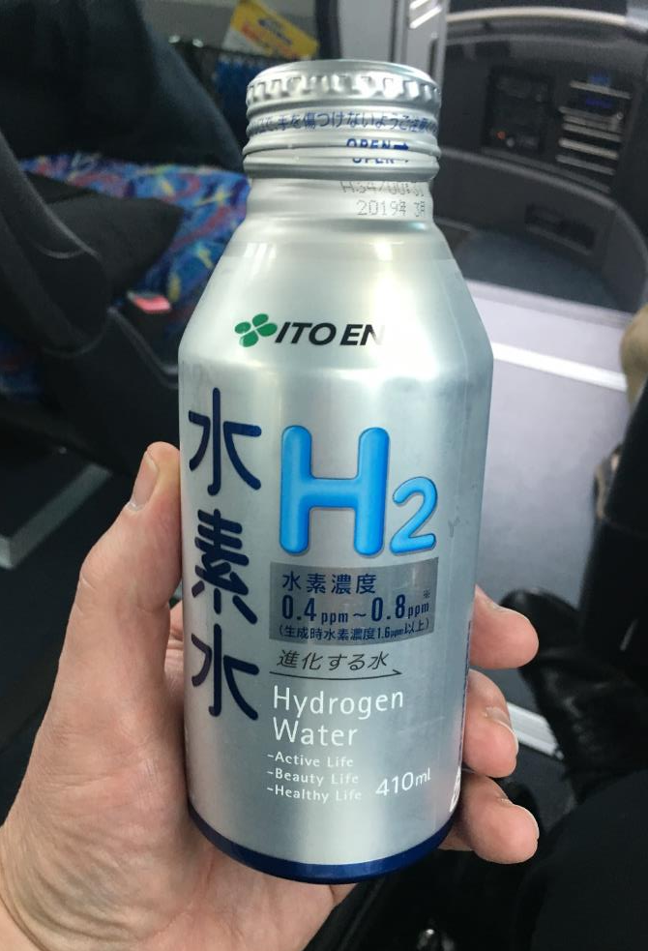
Hydrogen Applications – Who Knew?
S. Korea
Japan
Notes:
And so now let’s look at where the applications sit.
The first set of applications are where the cost of hydrogen is already competitive. That is in vehicle applications, where the incumbent energy source is typically diesel or petrol. These applications are still hampered by infrastructure barriers (for example refuelling stations) however, which sit outside this analysis
In the second set of applications, we see hydrogen becoming costs competitive once the cost of hydrogen has dropped towards our best case scenario. Again, infrastructure barriers will likely apply to these also, but are not modelled here.
In the 3rd and 4th set of applications, the low cost of the incumbent energy source (for example natural gas for residential heating), means either that the cost of hydrogen will need to drop further than the scenario, or the existing costs will need to increase in order for hydrogen to displace the incumbent.
And so this graph essentially identifies the ‘low hanging fruit’ for an Australian Hydrogen Industry.
Now, let’s zoom in on one of these application areas which is particularly important to Australia, Export

Slide 28
We deliver Australia’s energy future
Working with industry across the energy value chain
Applying large-scale infrastructure to high-impact science
Applying innovative Australian solutions to international energy challenges
Significant track record of trusted R&D
Thank you
Energy
E-mail: patrick.hartley@csiro.au

Slide 29
Notes:
And of course much comes down to cost. This is some work from Japan which compares the relative economics of the different hydrogen transport pathways. You can see that overall they are relatively similar, however the costs are different for different stages of the various processes….ultimately technological improvements in these areas will likely change these graphs a lot

Slide 30
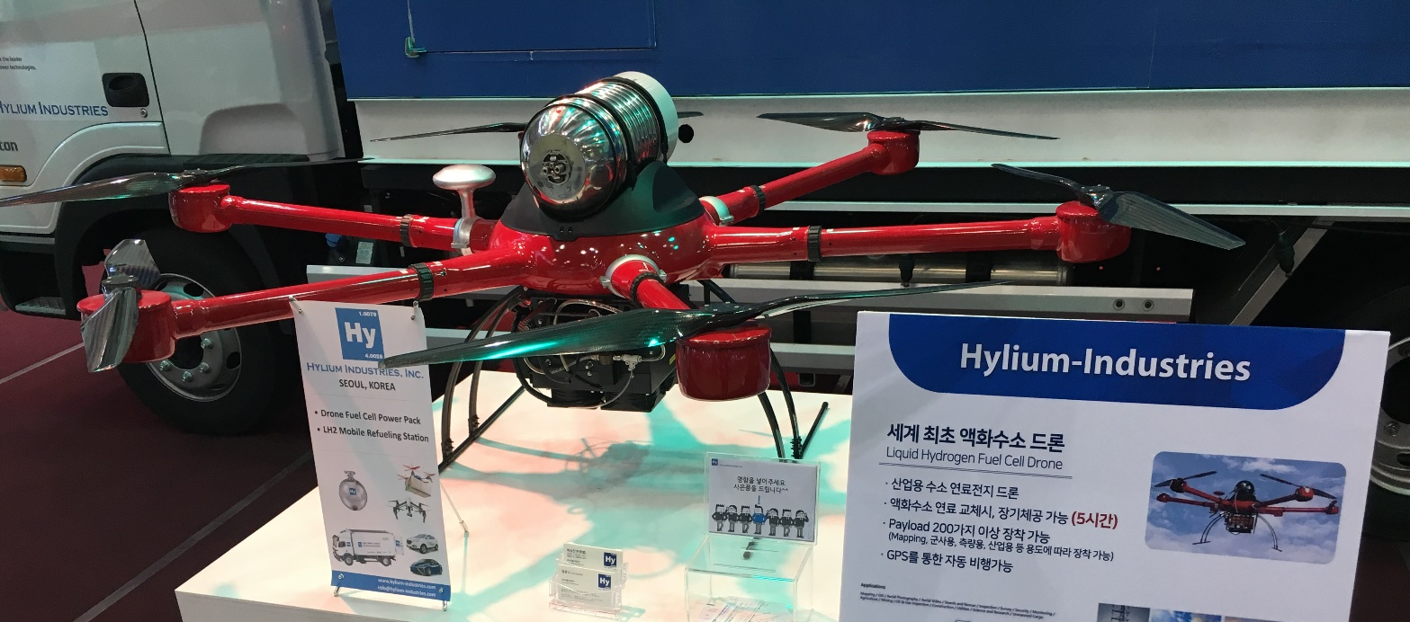
Hydrogen in Transport: Drones
Hylium Hydrogen Fuel Cell Drone
9l / 35MPa Storage
5 Hour Flight Time
Notes:
And so now let’s look at where the applications sit.
The first set of applications are where the cost of hydrogen is already competitive. That is in vehicle applications, where the incumbent energy source is typically diesel or petrol. These applications are still hampered by infrastructure barriers (for example refuelling stations) however, which sit outside this analysis
In the second set of applications, we see hydrogen becoming costs competitive once the cost of hydrogen has dropped towards our best case scenario. Again, infrastructure barriers will likely apply to these also, but are not modelled here.
In the 3rd and 4th set of applications, the low cost of the incumbent energy source (for example natural gas for residential heating), means either that the cost of hydrogen will need to drop further than the scenario, or the existing costs will need to increase in order for hydrogen to displace the incumbent.
And so this graph essentially identifies the ‘low hanging fruit’ for an Australian Hydrogen Industry.
Now, let’s zoom in on one of these application areas which is particularly important to Australia, Export

